Slide 1
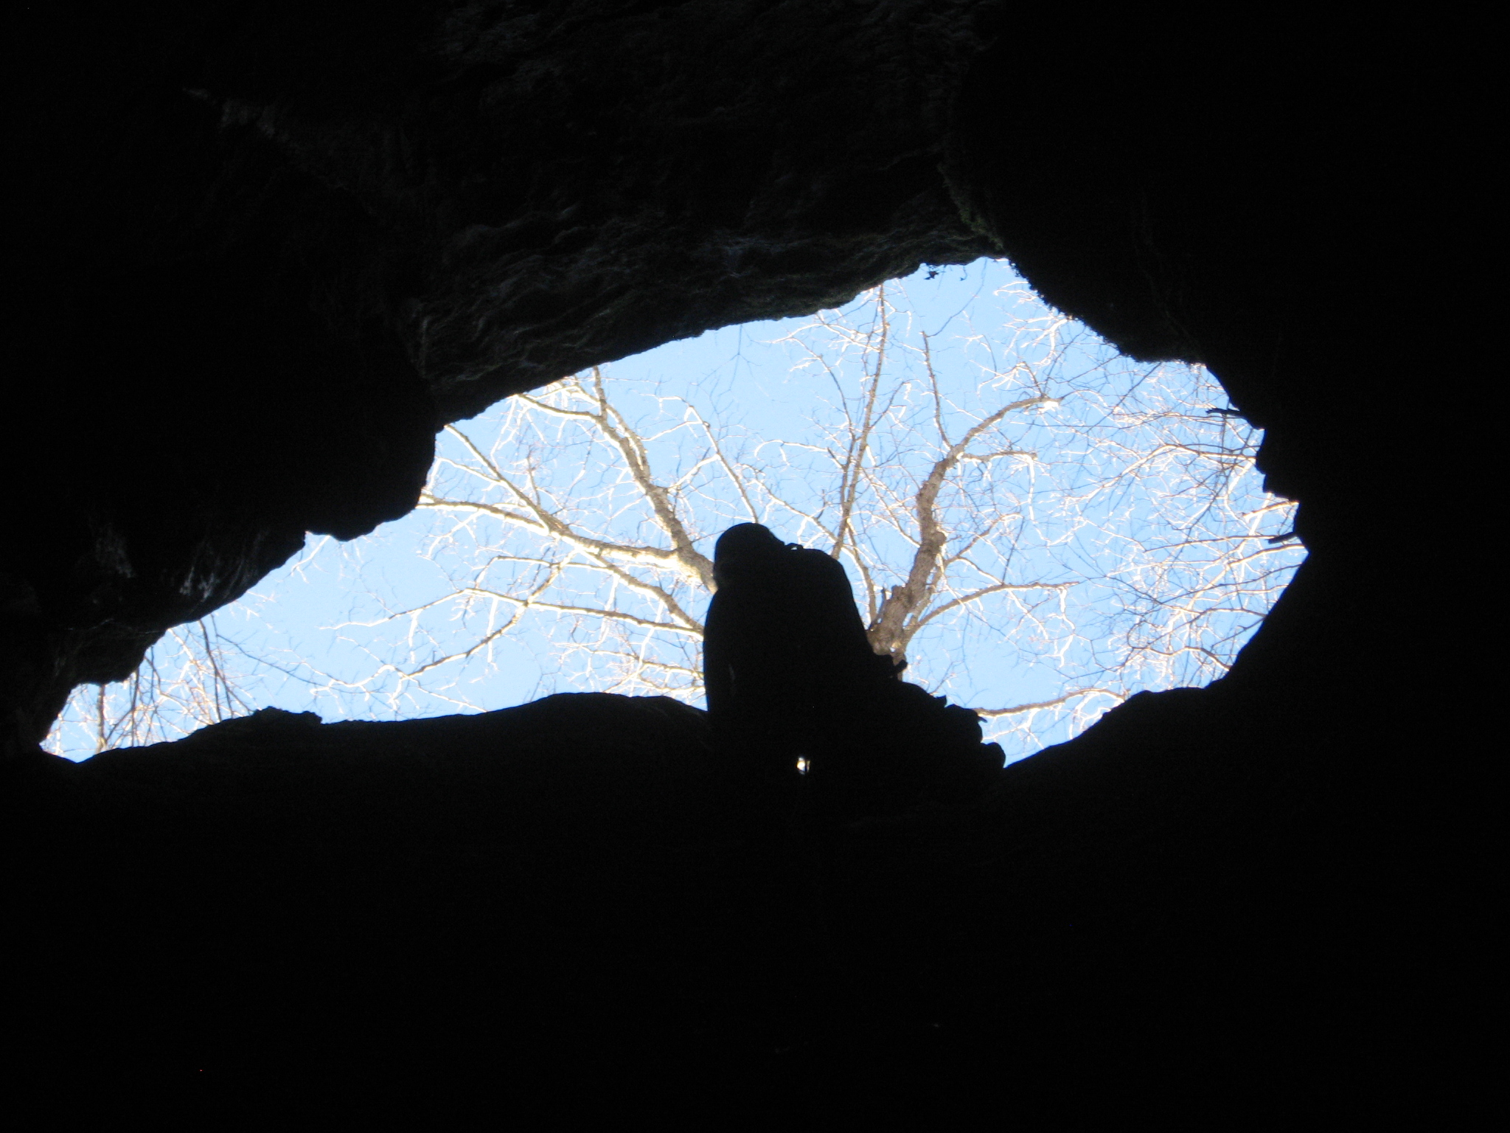
An Introduction to Caves and Karst
Carol Zokaites
Chief of Environmental Education
Virginia State Parks in the Department of Conservation and Recreation
and National Coordinator of Project Underground
Photo by Joe Zokaites
Notes:
Slide presentation for the BatsLive Cave and Karst webinar, The World Beneath Our Feet, Oct. 11, 2012.

Slide 2
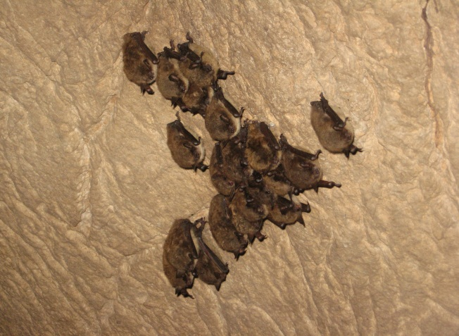
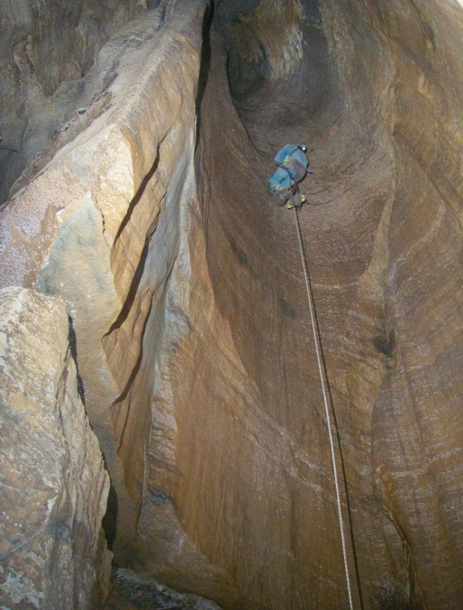
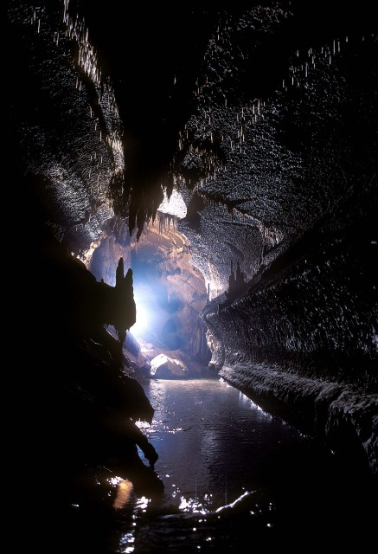
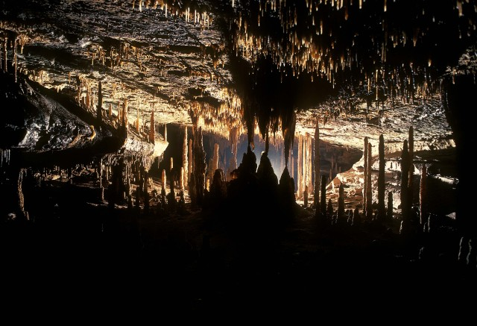
Raise a hand if you have
been in a cave.
Photo by Joe Zokaites
Caves
Photo by Carol Zokaites
Photo by Chip Clark
Photo by Chip Clark
Notes:
Most people are familiar with the pretty cave photos and the amazing formations like Stalagmites and Stalactites. Caves are home to many animals and unique habitats and offer great adventure to cave explorers and scientists.

Slide 3
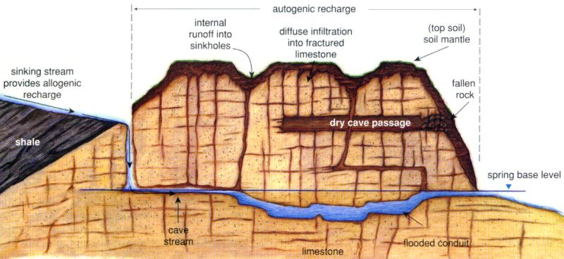
Karst -- A unique type of landform
- characterized by subsurface drainage systems, sinking or losing streams, sinkholes, big springs, and caves.
- formed by the dissolution of limestone, dolomite, marble, or other soluble rocks
Cross-section diagram by David Culver, American University.
Notes:
Karst – the type of landform where caves are found. It is underlain by the soluble sedimentary rocks – limestone and dolomites. Over geologic time these soluble rock formations dissolve from slightly acidic groundwater to form the karst topography and open cave passages which become conduits for groundwater flow.

Slide 4
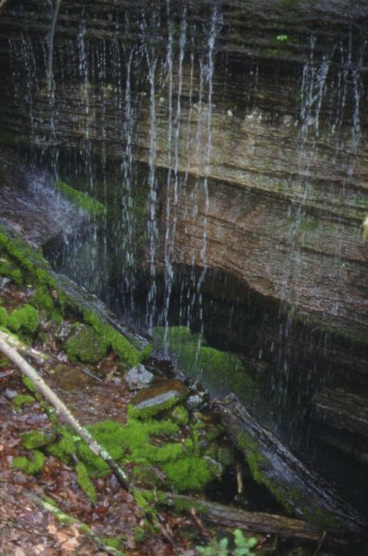
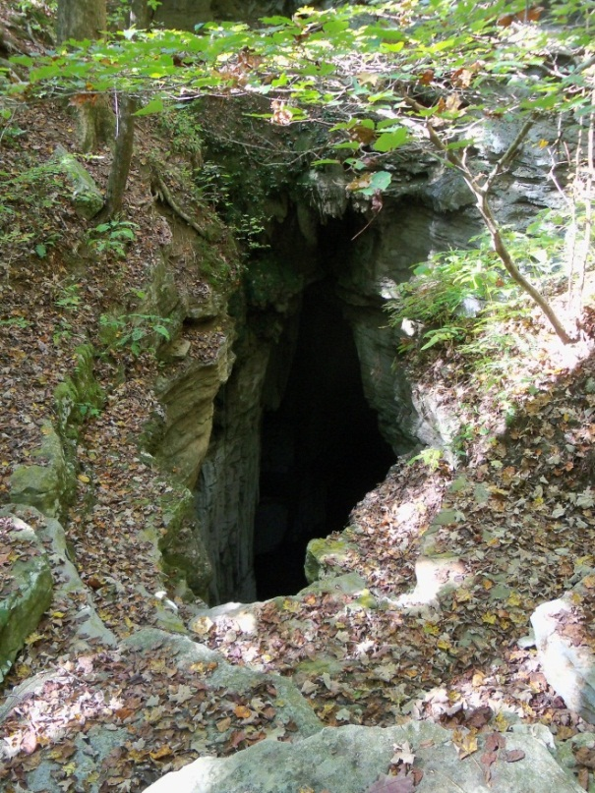
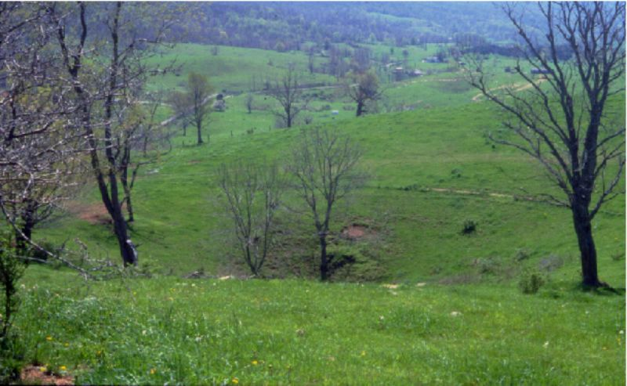
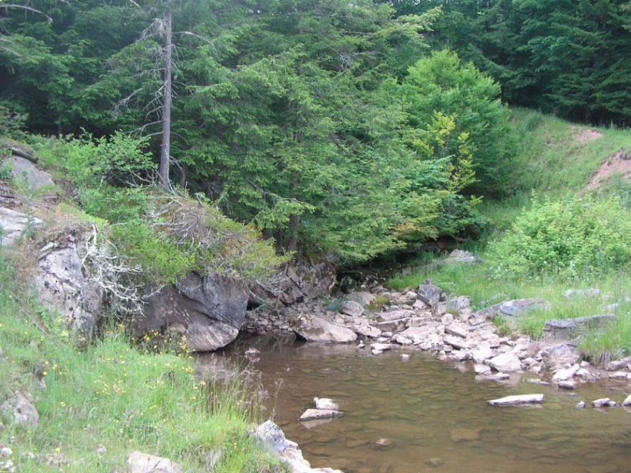
Karst
A land area with Sinkholes, Springs,
Sinking Streams
and Caves
Sinking Streams
Caves
Photo by John Bowling
Springs
Sinkholes
Photo by Ed Fortney
Notes:
Formed by slightly acidic groundwater dissolving the soluble limestone and dolomite

Slide 5
National Karst Map by USGS, from Dr. Dan Doctor
Do you live in a karst area shown on this map? A – Yes B – No
Notes:
About 20 percent of the land surface in the U.S. is classified as karst. Additionally in the United States, about 40% of the groundwater used for drinking water comes from karst aquifers.

Slide 6
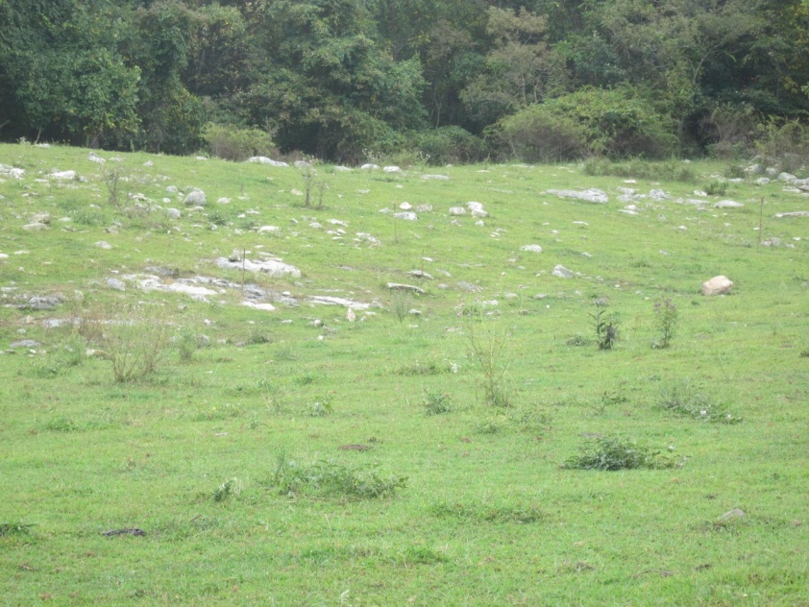
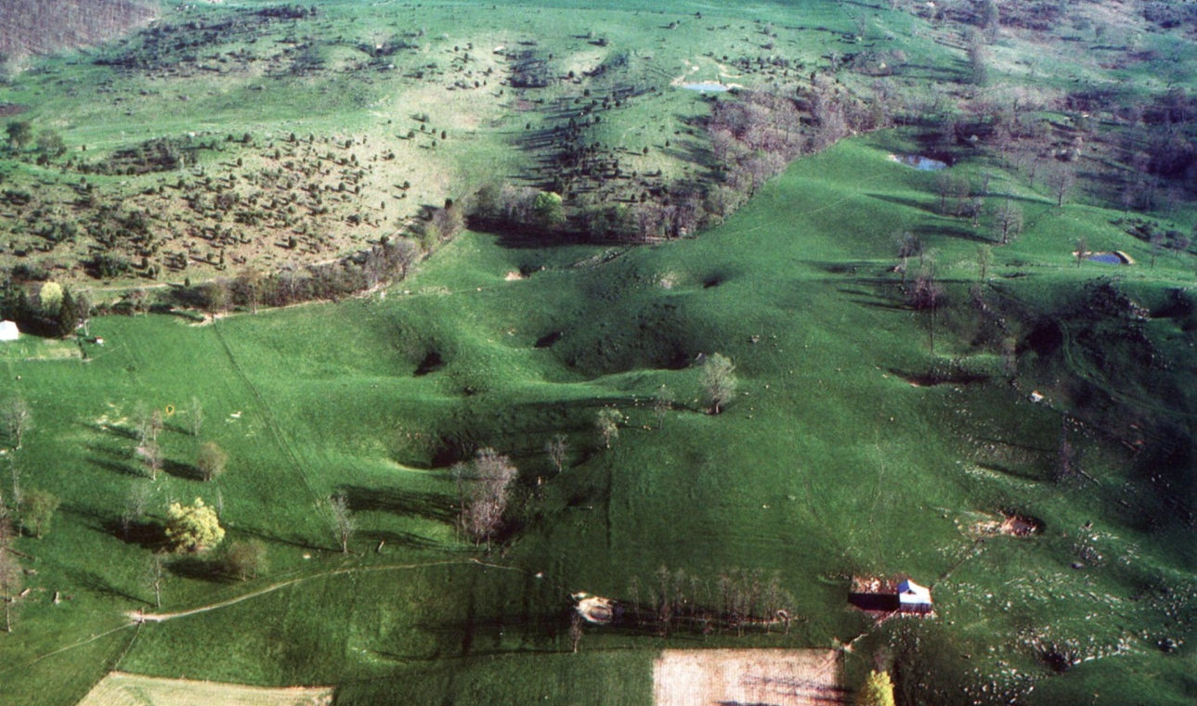
View of Karst Landscapes - thin and variable soil depths over the cavernous limestone. This allows rain and snow to enter the subsurface and groundwater quickly without a lot of filtration.
Sinkholes and
rocky fields
Photo by William K. Jones
Photos by Carol Zokaites
Notes:
Caves are big enough for a person to fit through, but how big of a crack in the rock does a rain drop need to enter the groundwater? Good overview of karst landscape – see the sinkholes? Very rocky fields.

Slide 7
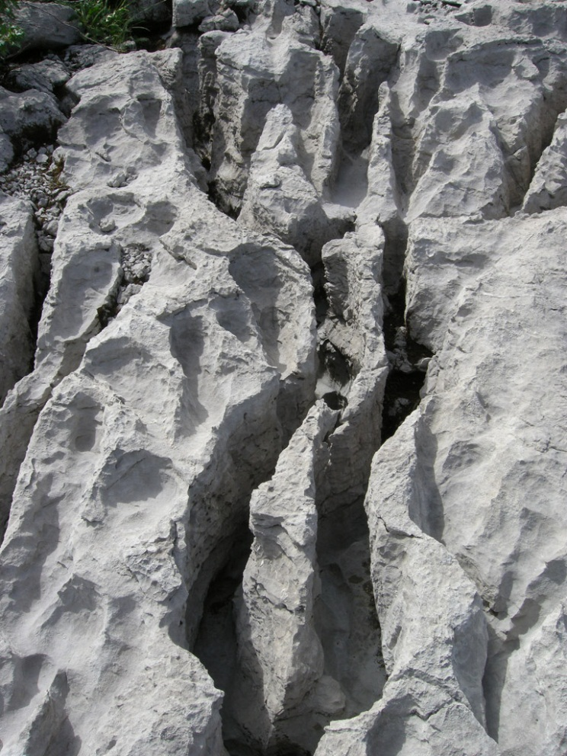
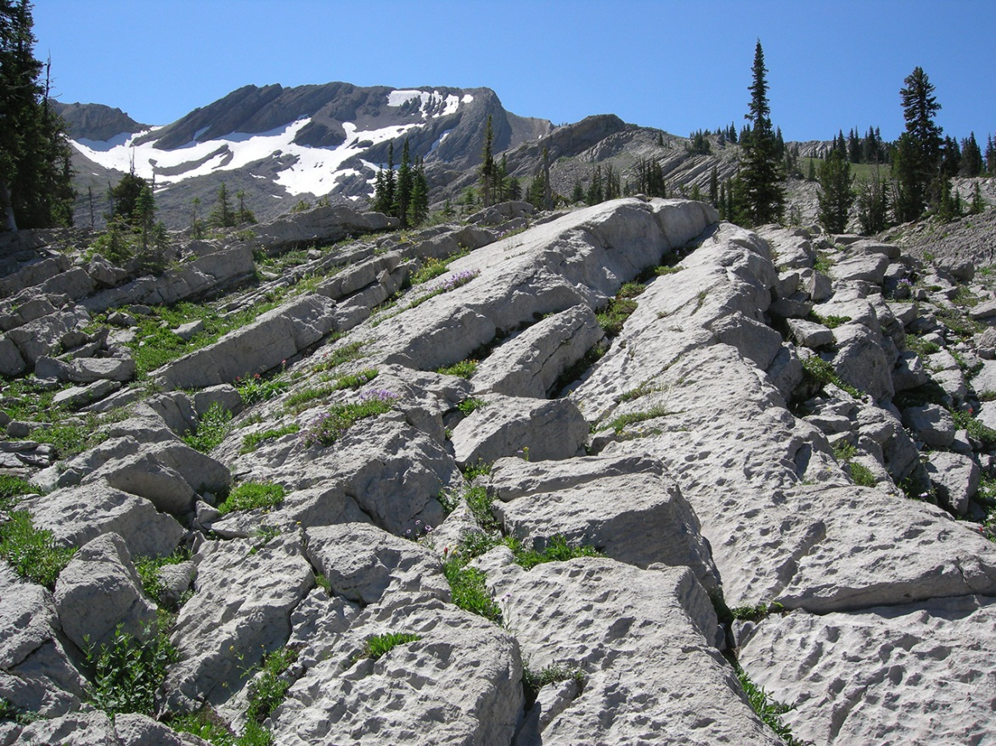
Alpine Karst is developed in mountain areas with a history of glaciation. Most of the soil has been removed by physical weathering exposing the beautiful rock surface called “karren”.
Photo by Dave Bunnell
Photo by Dave Bunnell
Notes:
While most karst in the US underlies well populated areas east of the Mississippi, karst occurs in a variety of other landscape settings as well. Most of the soil has been removed either by glaciers or by glacial melt waters, exposing the beautiful dissolved rock surface called “karren”. The world famous Castle Guard Cave in Alberta, Canada even has a glacier which plugs the end of the cave.

Slide 8
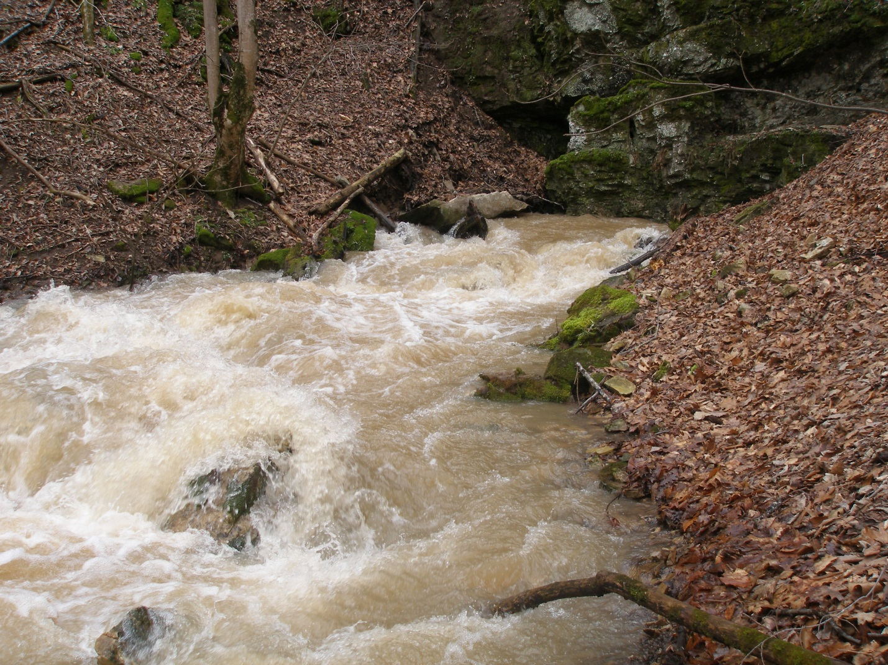
Why do you need to know about karst landscapes?
Surface water and groundwater interact very quickly in karst topography.
Here an underground
stream emerges from
a cave forming a karst spring.
Photo by Steve Wells
Notes:
Our drinking water supplies and recreation waters can be influenced by surface activity, including pollution issues, in karst areas because of this rapid interaction between the surface water and groundwater.

Slide 9
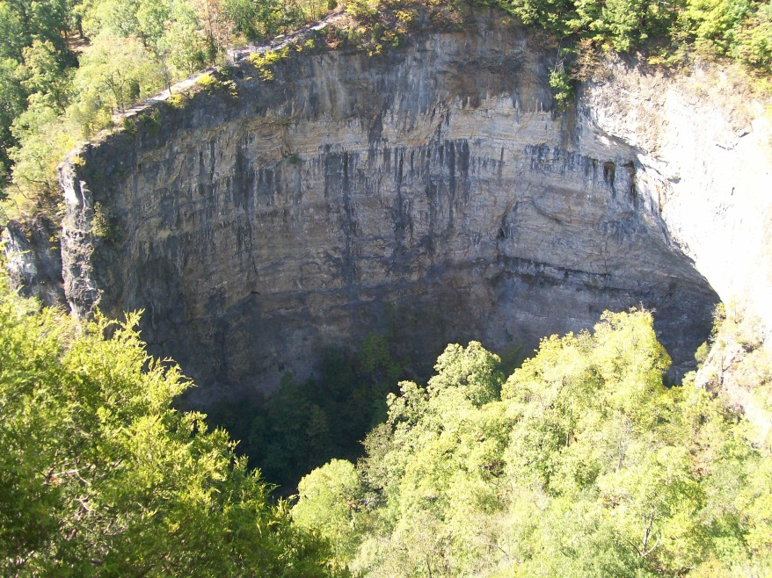
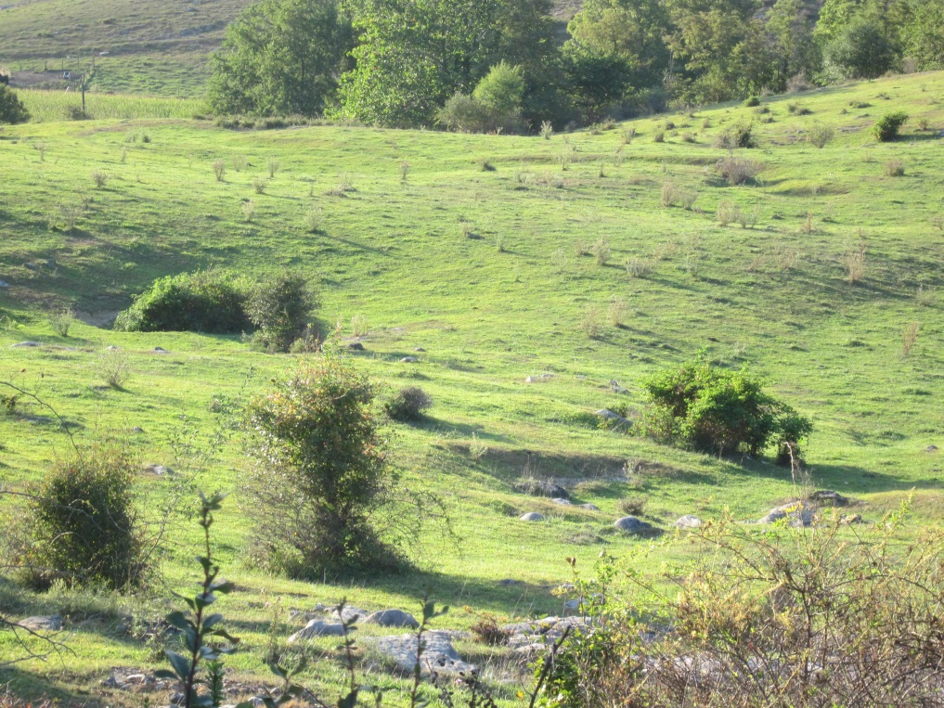
Sinkhole or Sink
A name for closed depressions. Sinkholes are one of the most obvious signs of a karst terrane..
Photo by Bill Douty
Sinkhole In A Cup
By Project Underground
on BatsLive website
Photo by Carol Zokaites
Notes:
Sinkholes form by the removal of surface materials into underlying open spaces. The surface material actually falls into the open spaces underground when it is no longer strong enough to support itself. Project Underground has a great activity showing how this works, called Sinkholes in a cup. There is link to this activity on the BatsLive website. Two types of sinkholes.

Slide 10
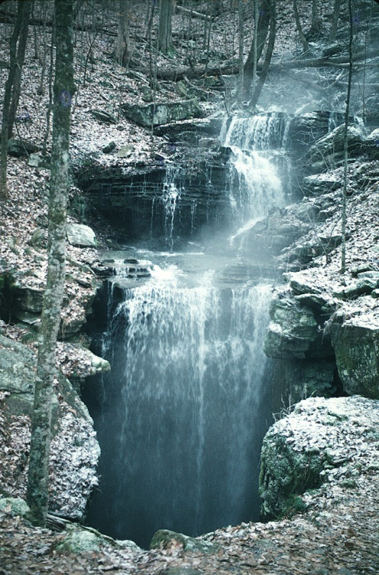
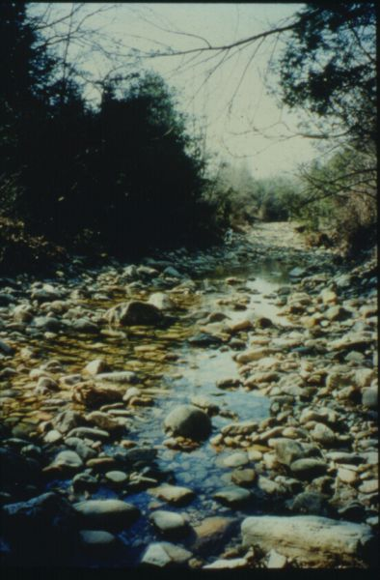
Sinking Streams Surface water becomes groundwater by streams sinking into the ground.
Photo by
Dave Bunnell
Photo from
VA Karst Program
Stream flows into cave at one location.
Water slowly dripping from a stream bed down into the underground.
Notes:
First one the entire stream is flowing into the cave entrance at one location – Second picture Water slowly dripping from a stream bed down into the underground drainage systems also called Losing Streams

Slide 11
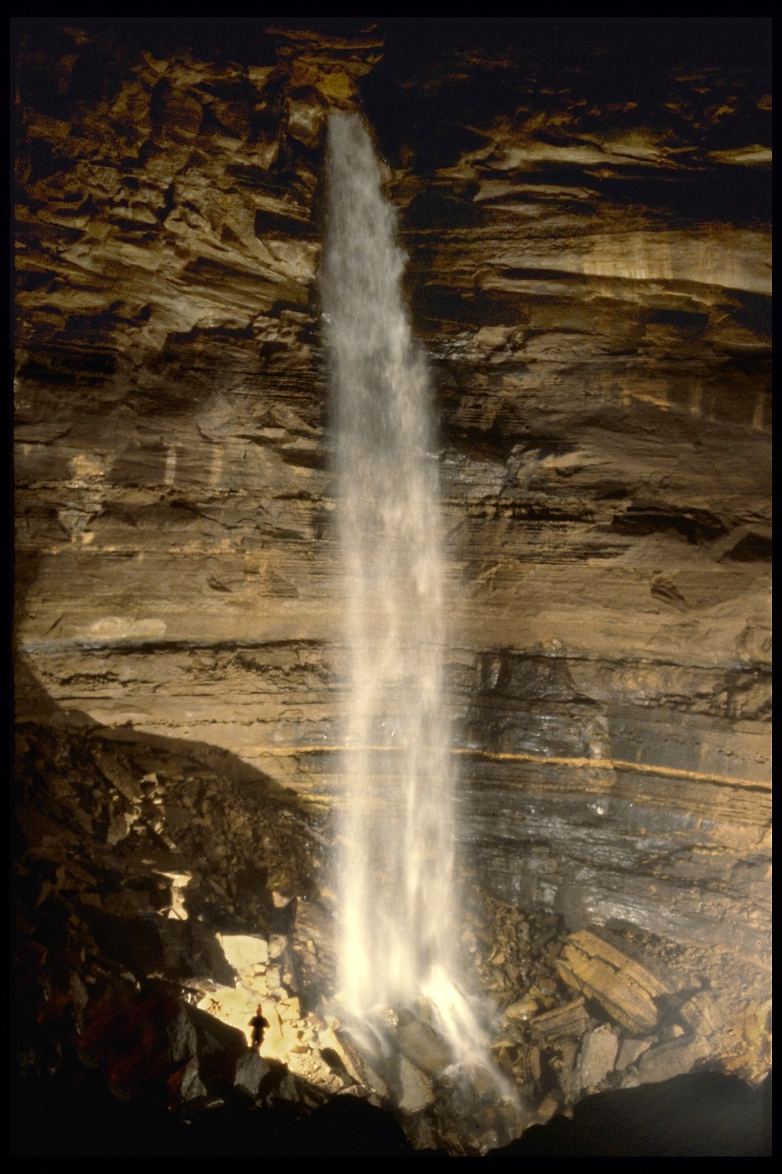
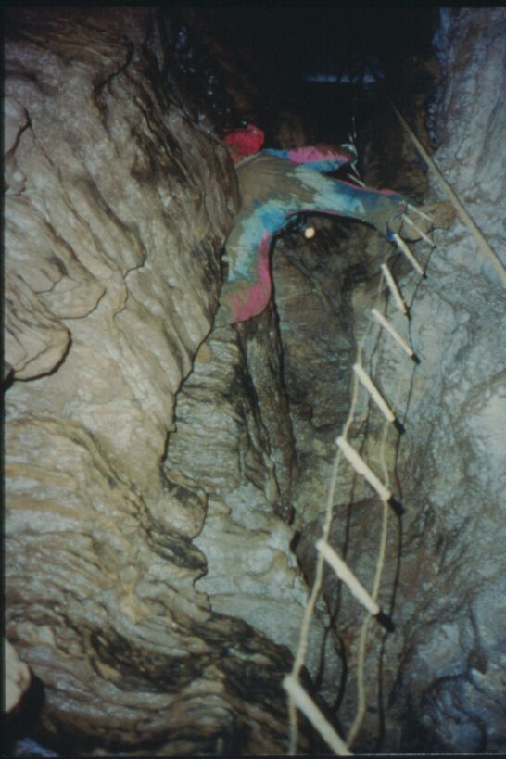
Water entering a cave flows through vertical conduits into the cavernous reservoir system below.
Photo from the VA Karst Program
Photo by Dave Bunnell
Notes:
Caves were formed by groundwater through geologic time and water still flows through them today.

Slide 12
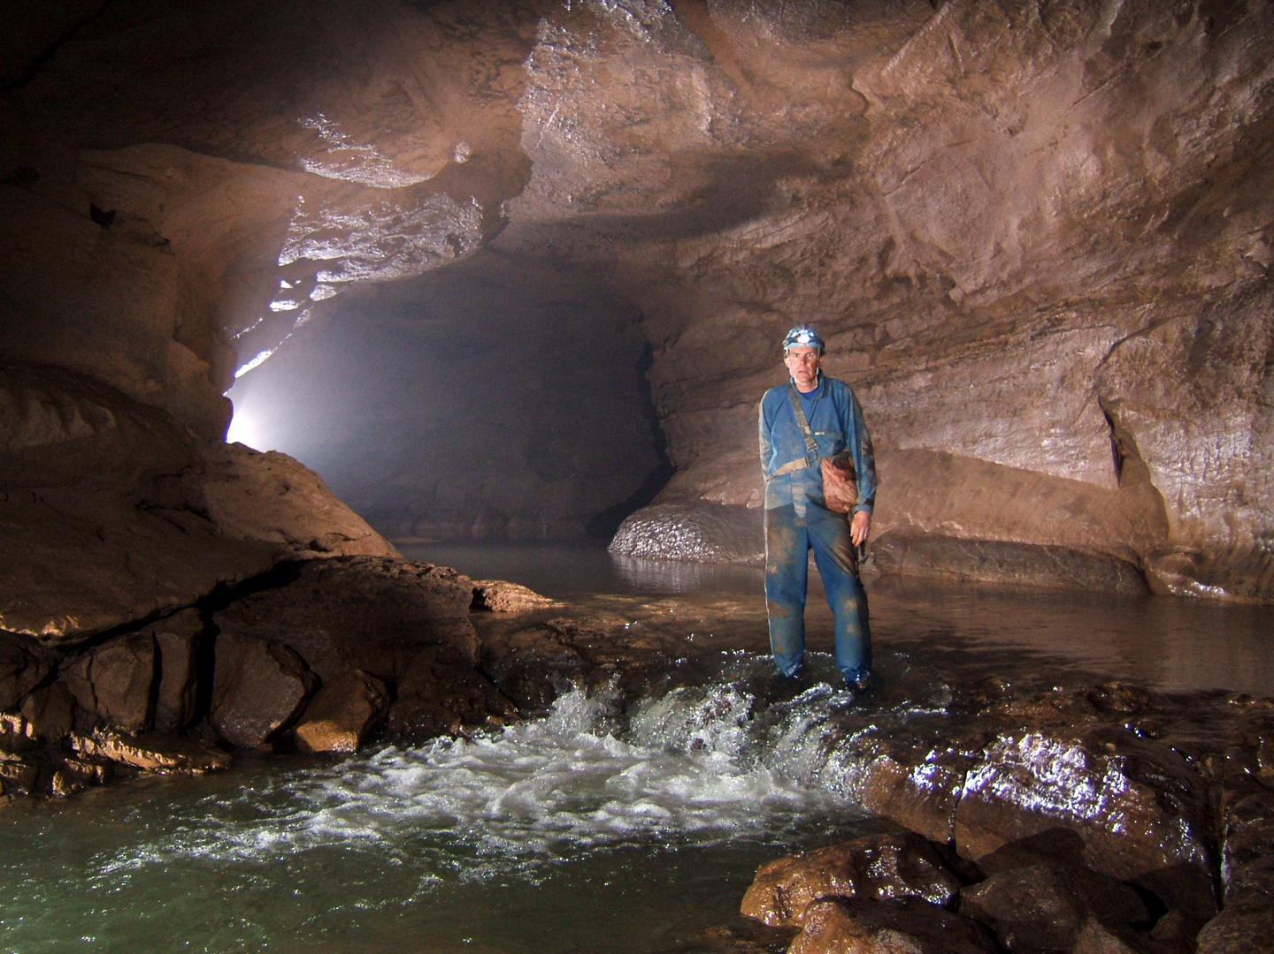
Water flows along the sculpted cave floor like a surface stream. Karst groundwater moves rapidly, up to several miles a day.
Photo by
Phil Lucas
Notes:
Streams flow underground just like they do on the surface. You can put an stick in an underground stream to see how fast the water is flowing just like in a surface stream.

Slide 13
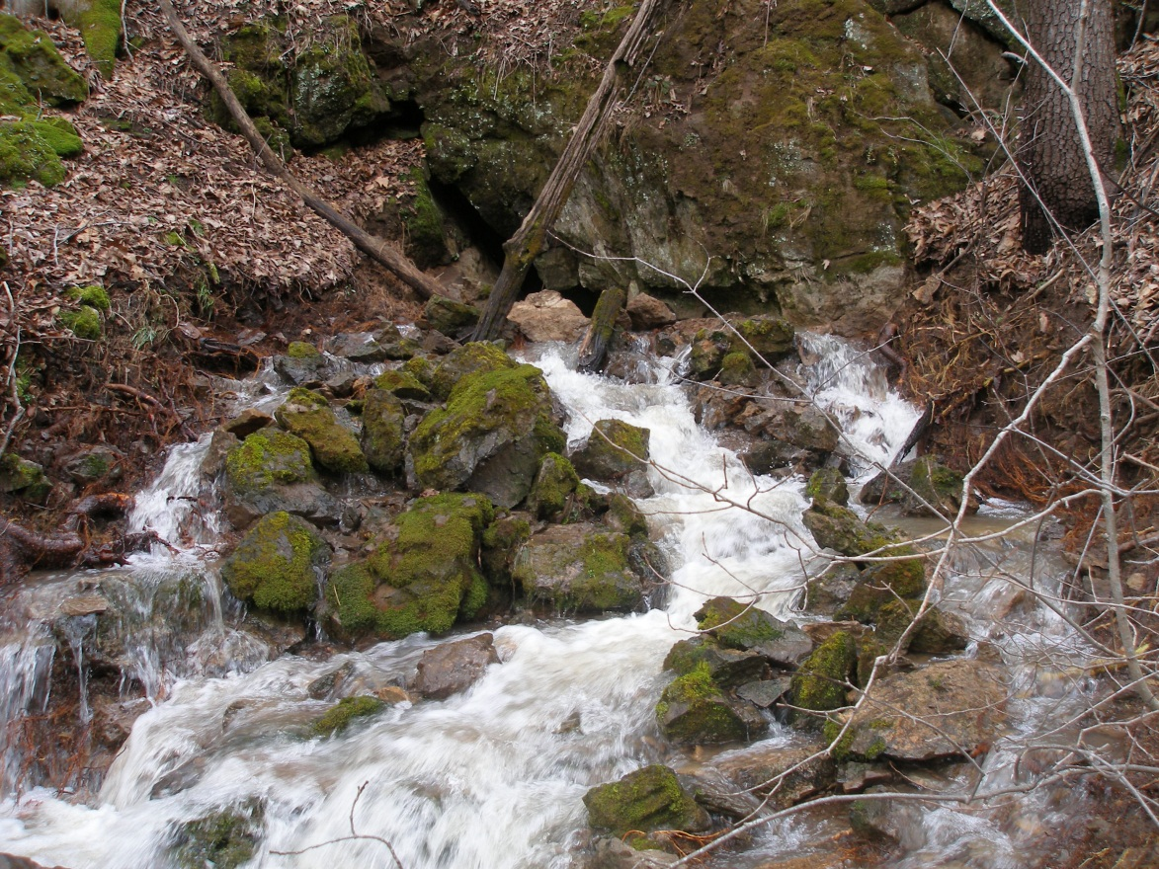
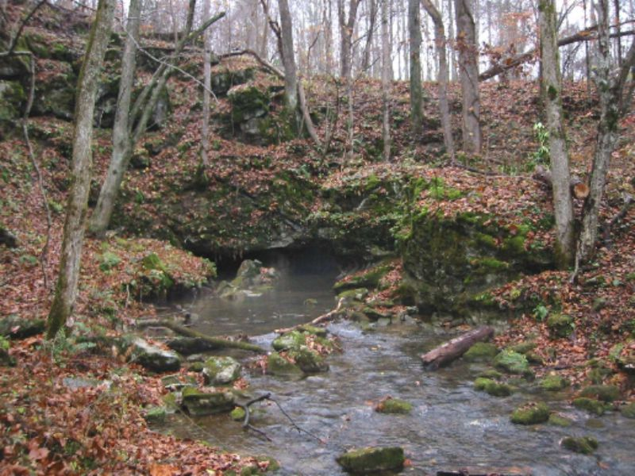
Springs
Most karst groundwater returns to the surface at springs.
Photo by Steve Wells
Do you get your drinking water from
a well or spring in a karst area?
A – No B – Yes, private well
C – Yes, public water supply well
D – I don’t know
Photo from VA Karst Program
Notes:
Many karst springs are used as water supplies, both public and private. Remember 40% of the groundwater used for drinking water in the U.S. comes from karst aquifers, mainly through springs and wells. How many of you have a well for your drinking water? Either at home or through your public water supply? Do you live in a karst area?

Slide 14
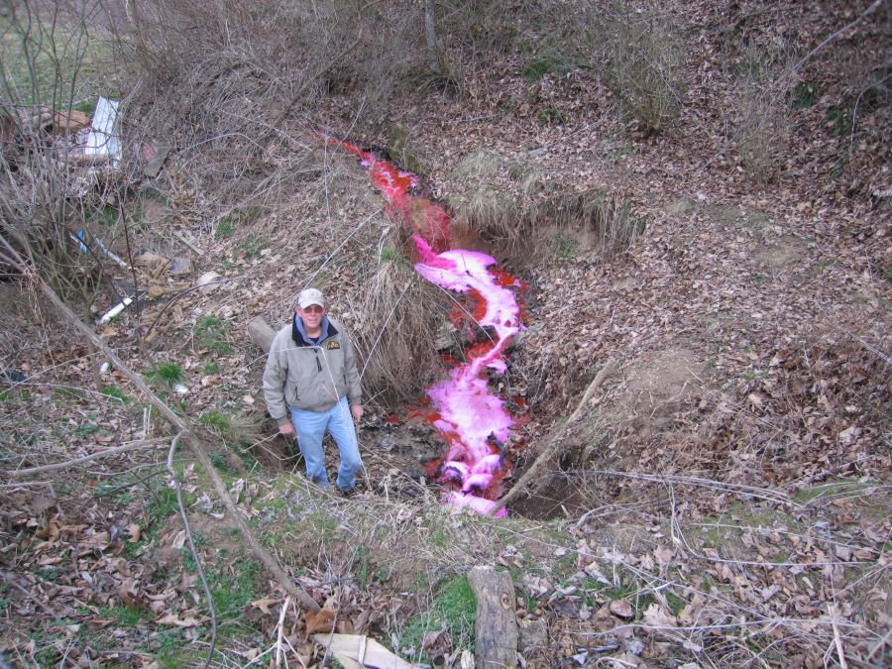
How do we know where the karst water
goes underground?
Photo from the
VA Karst Program
Scientists use nontoxic, fluorescent dyes to chart the
courses of underground streams and rivers.
Notes:
Dye tracing is the only way to verify where water flows underground since we can not see the underground water paths. The dye is put into sinking streams and it is caught with traps at springs and other stream access points like wells.
Dye tracing verifies where water flows underground since we can not see the underground water paths.

Slide 15

Video of Groundwater Model

Slide 16
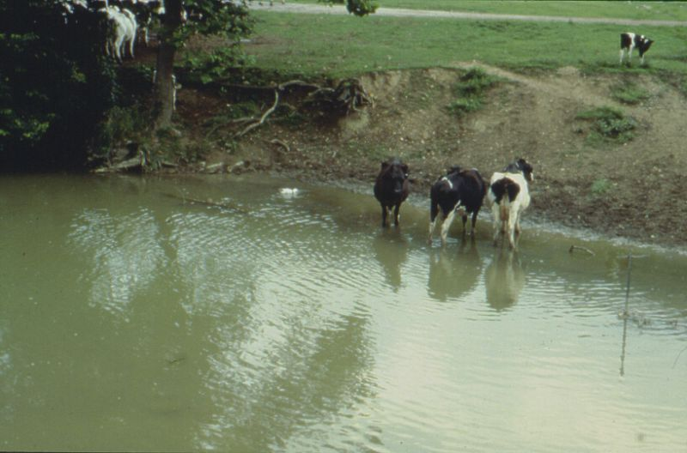
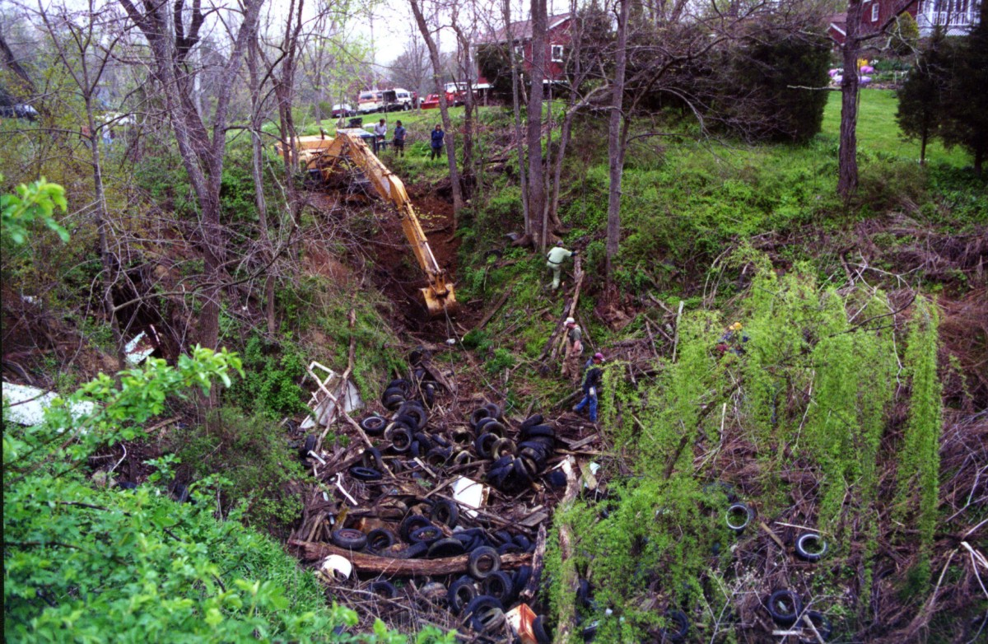
Threats and hazards in
Karst Environments
Sinkhole dumps Rain water flows through the sinkhole trash and into the groundwater.
Cows in the creek, anywhere USA
Photos from the VA Karst Program
Notes:
Soil and Water Conservation Districts and other natural resources agencies, both federal and state offer Best Management Practices (BMP) Programs to help landowners and localities in karst areas to keep the karst waters clean and unpolluted.

Slide 17
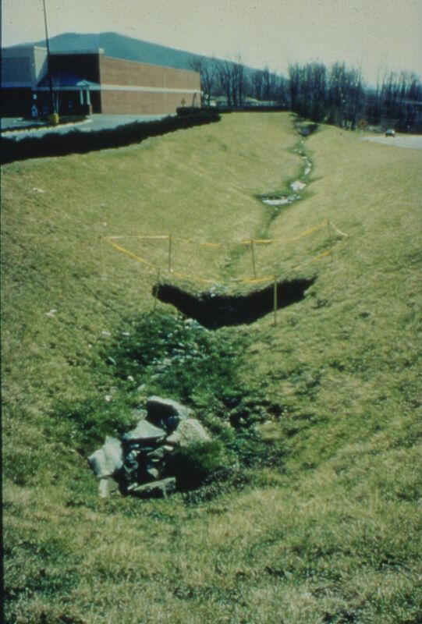
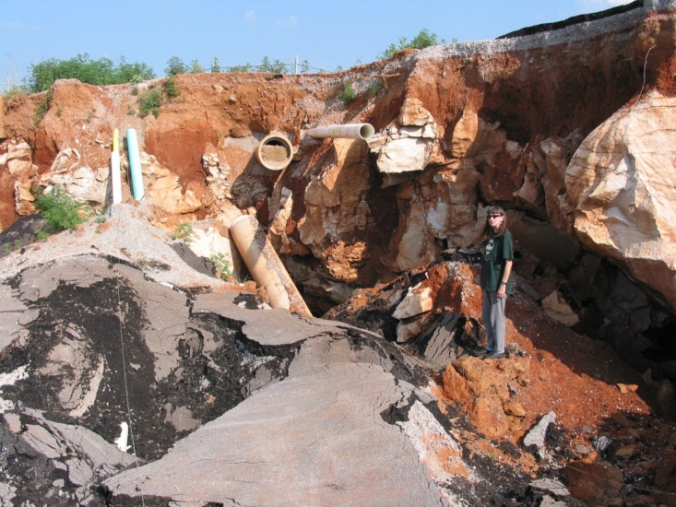
Threats and hazards in
Karst Environments
Stormwater runoff and road collapses
Photo from NCKRI
Best management practices and grant programs are available from many state and federal agencies to help keep the karst waters clean.
Photo from VA Karst Program
Notes:
Changing water flow by adding impervious cover like roads, parking lots and large buildings and channeling water into storm water settling areas can lead to the opening of soil pipes, or sinkholes into the conduits and groundwater below. Here the road collapsed into a sinkhole, meaning the road surface fell into the open spaces under the ground.

Slide 18
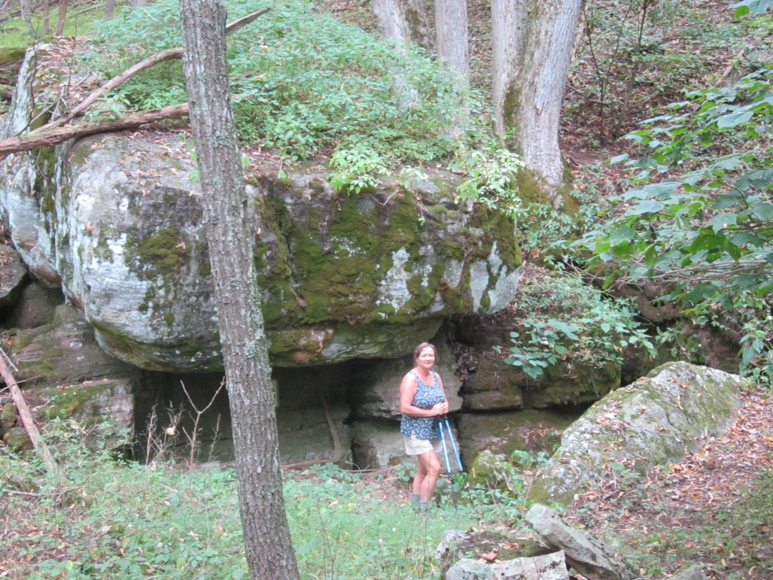
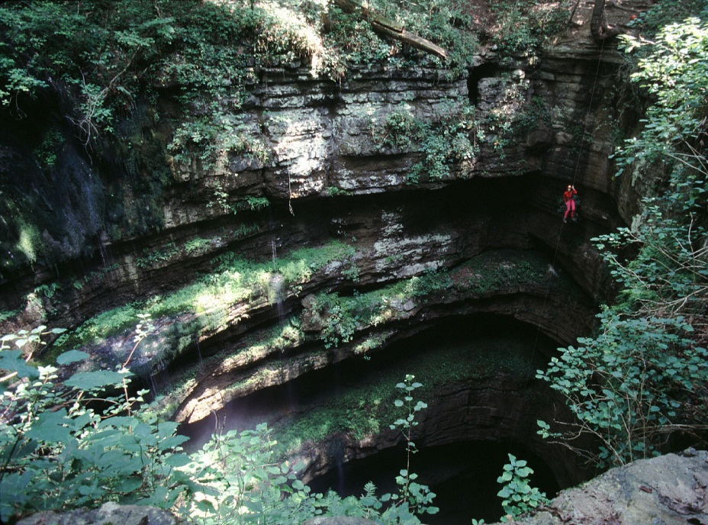
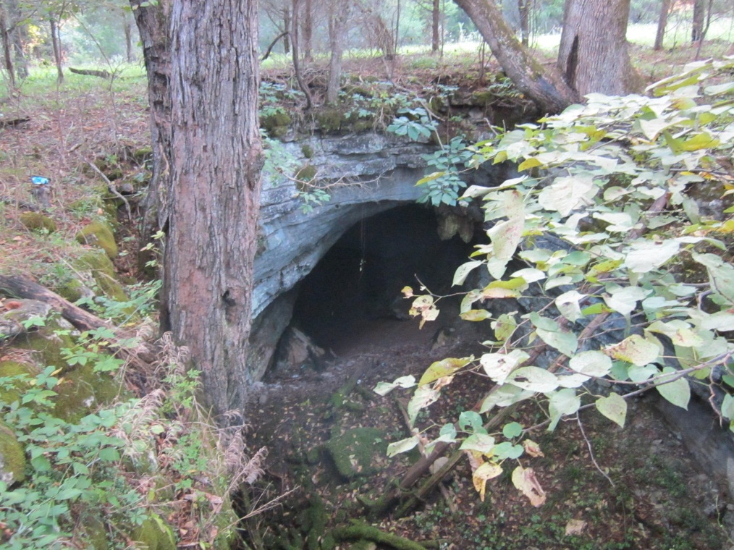
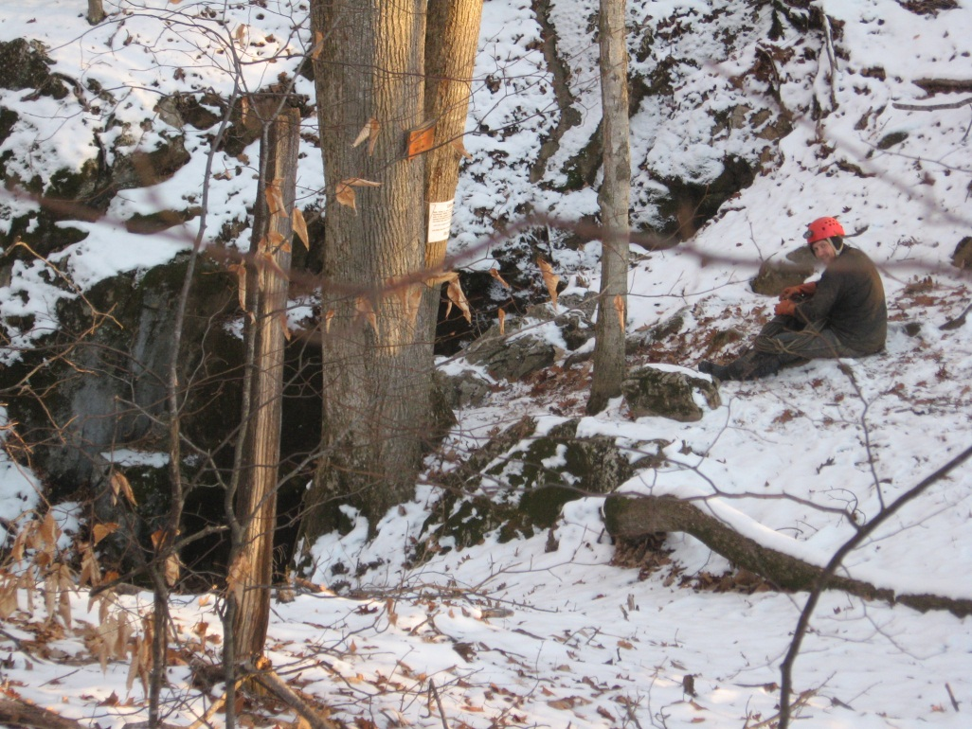
Cave entrances in Karst areas
Joe Zokaites
Dave Bunnell
Carol Zokaites
Joe Zokaites
Notes:
The last of the karst features to discuss today are the caves. Cave entrances in karst vary in size and shape. Formed in the soluble sedimentary bedrock, Limestone, Some of these cave entrances have deep pits into sinkholes, some hide in rock outcropping, while some are easy to walk in to.

Slide 19
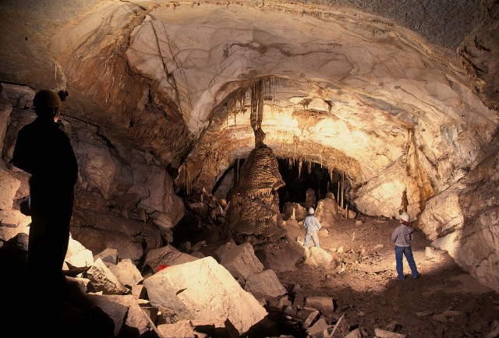
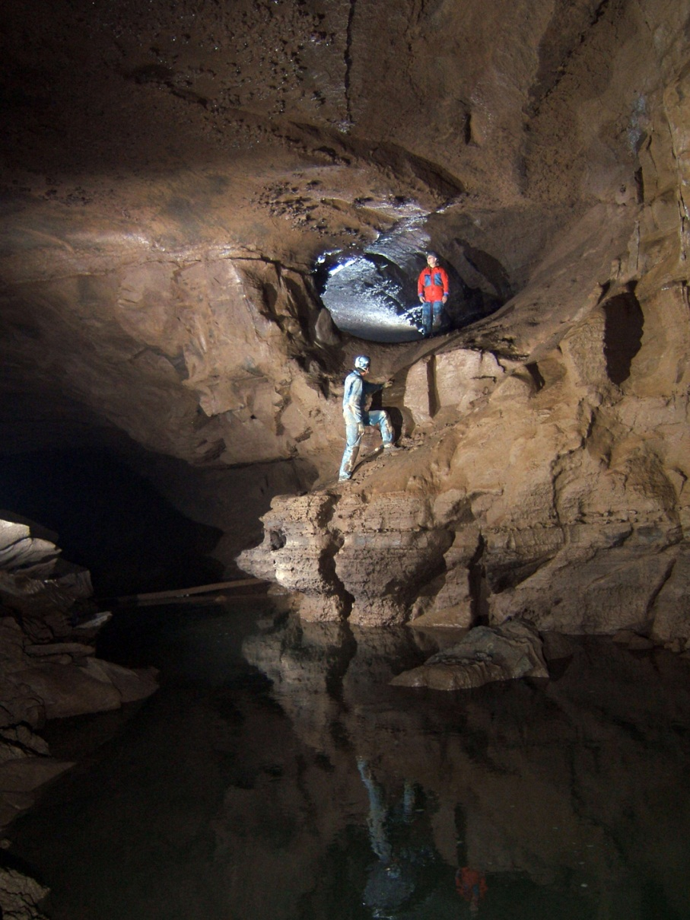
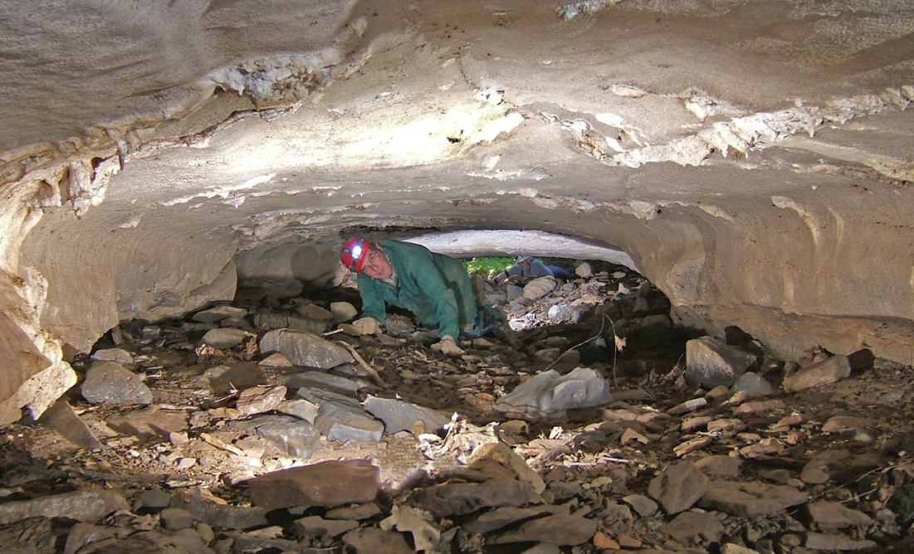
Cave Passages
Photo by Chip Clark
Photo by Phil Lucas
Photo by Phil Lucas
Notes:
Cave entrances lead into wonderful underground passages – Though geologic time slightly acidic groundwater formed these cave passages.

Slide 20
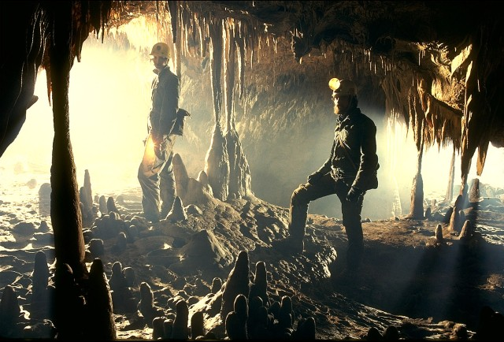
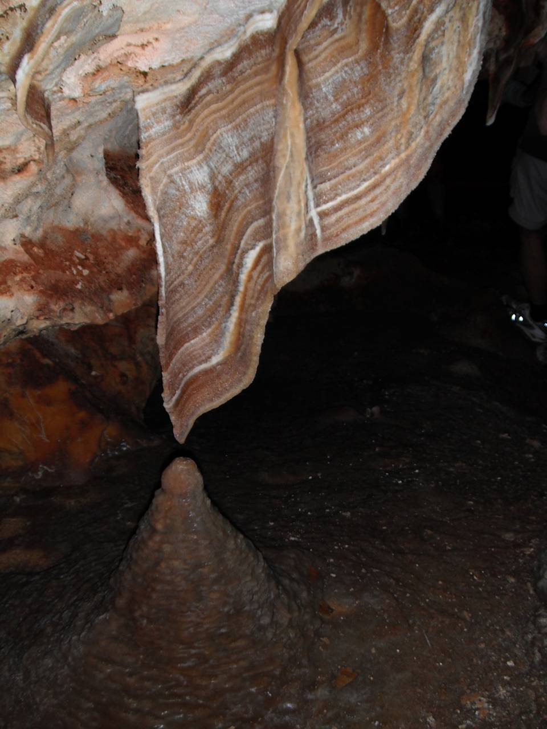
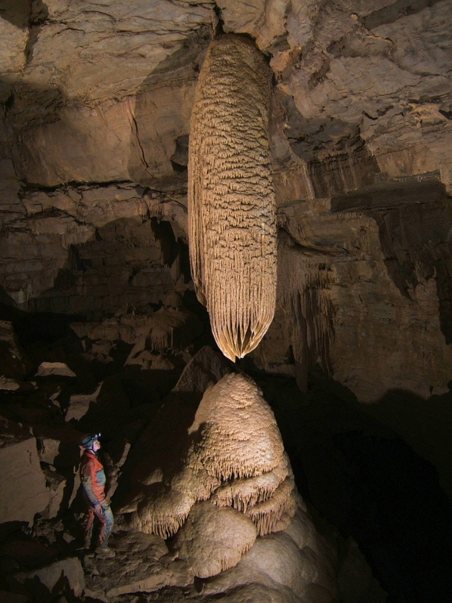
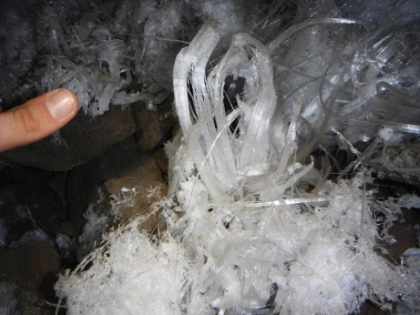
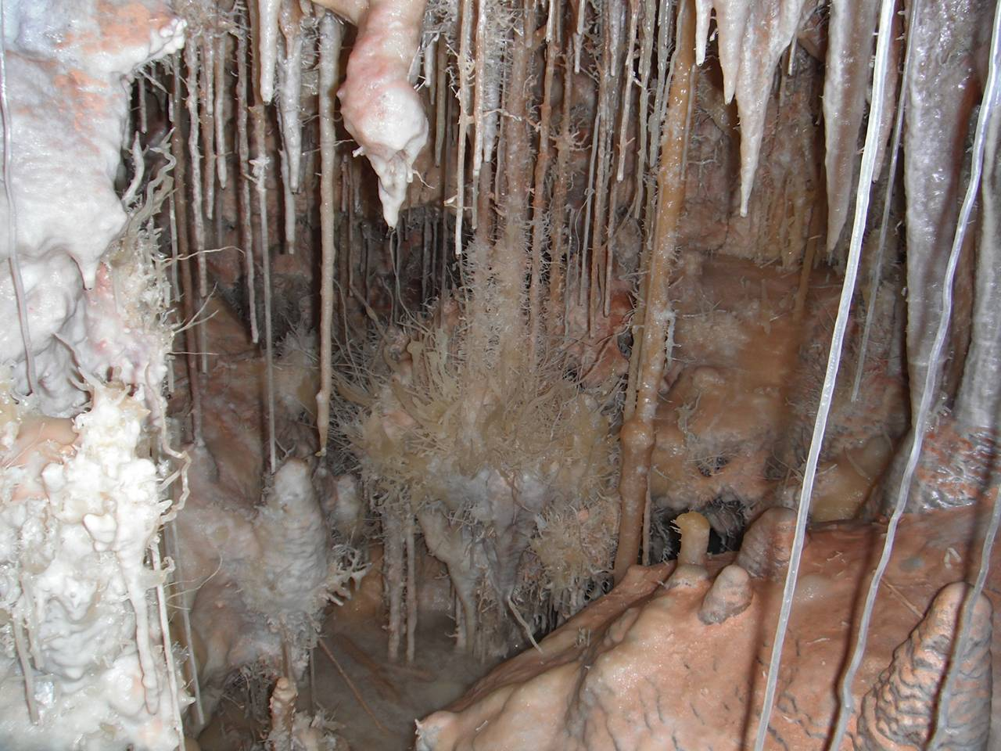
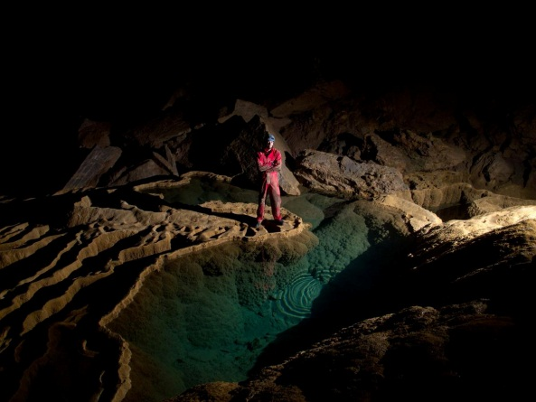
Cave
Formations
Photo by Liana Boop
Photo by Chip Clark
Photo by Chip Clark
Photo by Liana Boop
Photo by Liana Boop
Photo by Phil Lucas
Photo by Phil Lucas
Photo by Carlin Kartchner
Notes:
Cave also contain amazing cave formations.

Slide 21
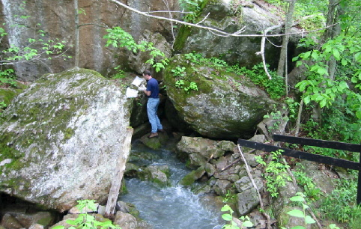

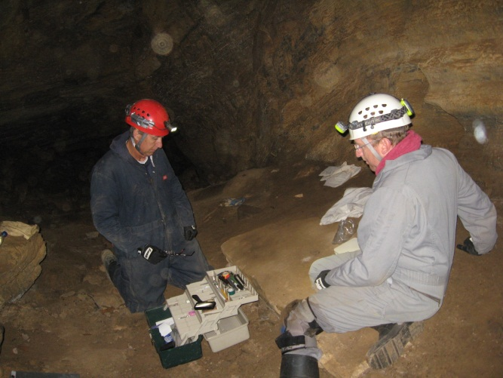
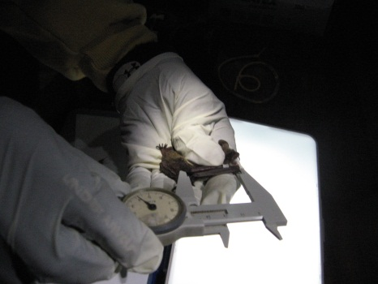
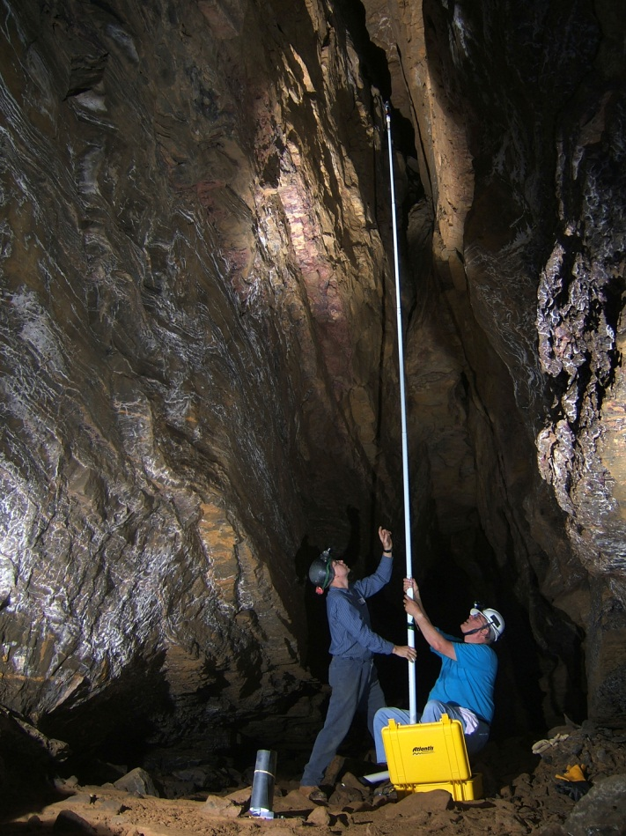
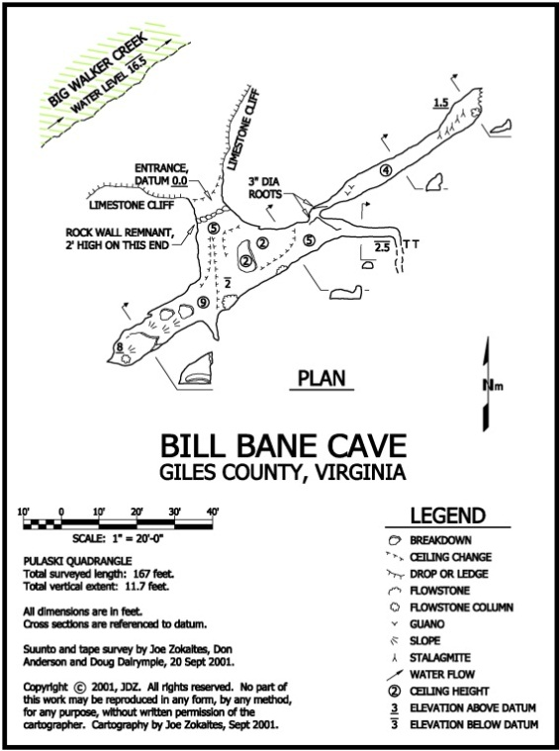
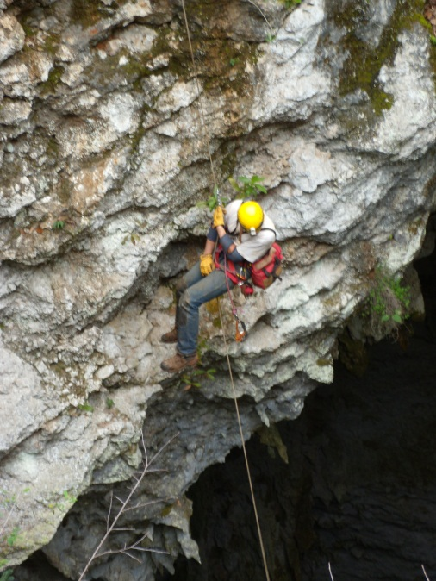
Photo by Karen Franzl
Photo by VA Karst Program
Cave scientists study the geology, biology, hydrology and paleontology of the
cave and karst systems.
Photo by VA Karst Program
Photo by Carol Zokaites
Photo by Phil Lucas
Map by Joe Zokaites
Notes:
Scientist study the cave and karst environments, collecting data, creating maps, participating in research projects and monitoring the karst waters. This presentation has introduced the hydrology and geology of caves, the next presentations will cover biology and paleontology. STEM subject – outside fieldwork might be more interesting than office computer jobs. We need to train more scientists.

Slide 22
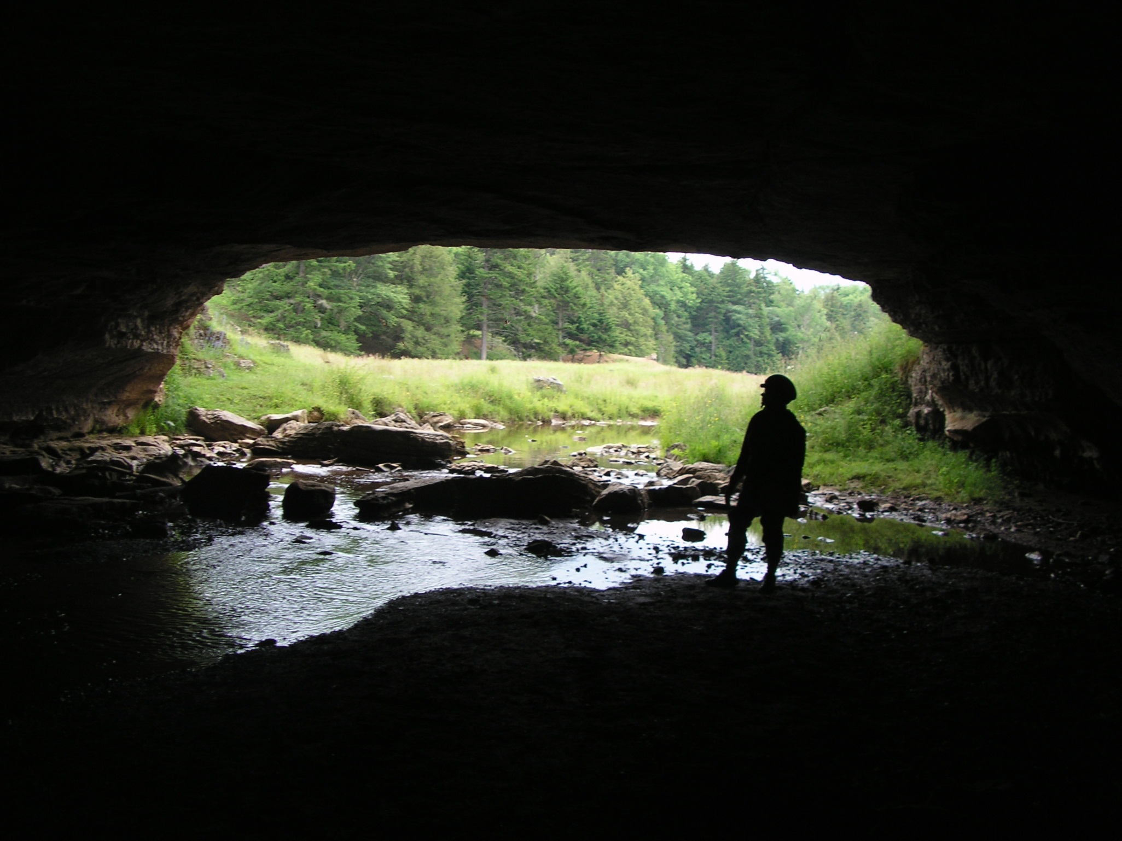
Karst landscapes host productive aquifers, amazing caves,
sinkholes, sinking streams and springs.
Photo by Ed Fortney
Notes:
This presentation introduced you to caves, karst topography and karst water supplies. I hope you will continue to learn about and appreciate these wonderful natural resources.

